Slide 1
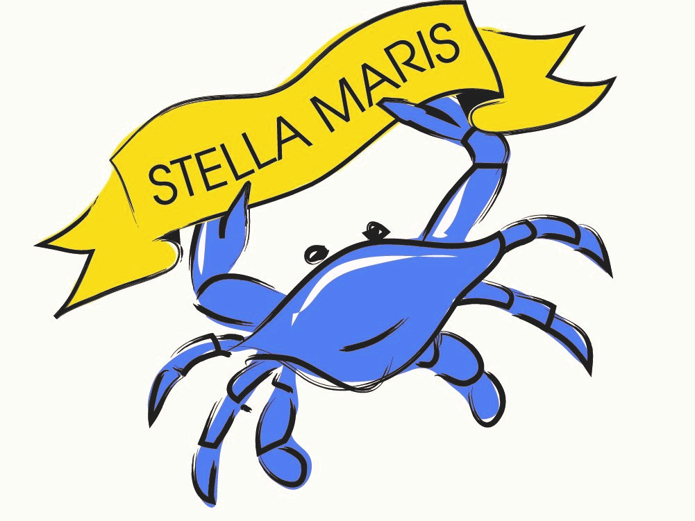
A Message from Our
Leadership Committee Chair
Kali Mallik
For the last 10 years, I have been a Home and In Patient Unit (IPU) volunteer of the Stella Maris Hospice Program. It has been an extremely rewarding experience...the invaluable time I spend with patients provides with me such positive energy and invigorates me.

Slide 2
As a volunteer, I try to help patients (and their families) with non-medical needs which range from offering water, coffee or ice cream to taking a short peaceful walk. I try to provide comfort which can be as simple as helping the patient get repositioned with a nurse or sometimes just spending quality time. On occasion, hospice patients have family members that live far away so I try to serve as a friendly companion and we have fun exchanging life stories.

Slide 3
One story that exemplifies the profound impact that
Stella Marris has had on me occurred 7 years ago with a patient named Evelyn. Her son placed her in hospice care, but she was hoping to get better and one day return home. Unfortunately, her family could not visit her daily and sometimes she became lonely. We developed a strong friendship and bond. She always was so happy to see me
and this, of course, made my heart full. I saw her the day before Thanksgiving and I had mentioned that I would
not be able to visit her tomorrow because my kids were coming into town.

Slide 4
But, since she would not be seeing her own family on Thanksgiving, she started choking up and asked again for me to visit her. This heartfelt request moved me...so, I stopped by on Thanksgiving to see her...she was so thrilled that she grabbed me to give me a hug and kiss on the cheek. I told her that I would come back tomorrow if I had time...but, the next day I learned that Evelyn had passed away on Thanksgiving night. I was saddened but it was comforting to know that I spent some quality time with her towards the end of her incredible life.

Slide 5
By volunteering at Stella Maris, I get so much fulfilment in helping others. In addition to hanging out with my wonderful grandkids, my experience at Stella Maris provides me with so much joy in spending time with awesome human beings.

Slide 6
Also, the staff and I joke around a lot. One day, they handpicked me to act as patient in a Stella Maris TV commercial. Of course I was honored but, then they said it would be a bath scene and I would have to be completely nude. I was a bit stunned and shocked...but, then I realized they were pranking me!

